Slide 1
Smishing in cybersecurity
CREATED BY E.MALAVIKA
DEPARTMENT NAME: COMPUTER SCIENCE AND ENGINEERING
COLLEGE NAME: AALIM MUHAMMED SALEGH COLLEGE OF ENGINEERING

Slide 2
PROBLEM STATEMENT
1.Increasing Smishing Threats : Smishing attacks have seen a significant
rise, posing a severe threat to individuals and organizations.
2.User Vulnerability :Users often fall victim to smishing due to lack of awareness and sophisticated social engineering tactics.
3. Financial and Data Loss :Smishing attacks result in financial losses and exposure of sensitive data, leading to severe consequences.

Slide 3
SYSTEM DEVELOPMENT APPROACH
ENCRYPTION
MULTILAYER SECURITY
Implement robust encryption
methods to secure sensitive data from smishing attacks.
Utilize multi-factor authentication and advanced security protocols to prevent smishing incidents.

Slide 4
Algorithm and Deployment
Data Analysis:
Utilize machine learning
algorithms to analyze smishing
patterns and identify potential
threats.
Real-time Monitoring:
Implement a system for real-time
monitoring and detection of
smishing attempts through
advanced algorithms.

Slide 5
CONCLUSION
1. Impactful Measures: The strategies and technologies implemente showcased a significant impact on combating smishing attacks.
2. User Empowerment: Empowering users with knowledge and tools proved to be a key aspect in preventing smishing incidents.
3. Continuous Adaptation: Continuous adaptation and innovation are vital to staying ahead of the evolving smishing landscape.

Slide 6
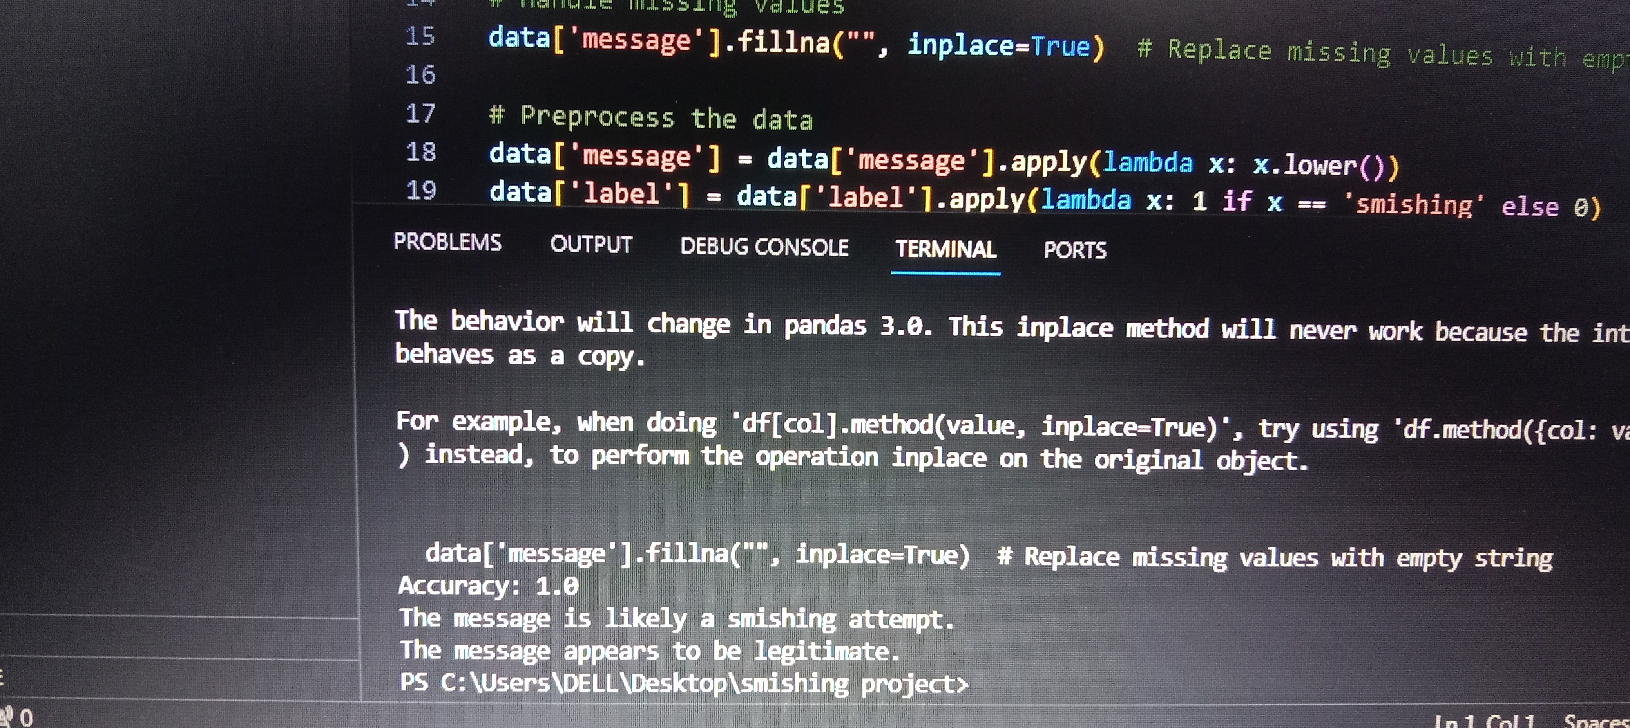
OUTPUT PICTURE OF SMISHING
This picture shows accuracy point as 1.0 and also gives two messages “1.the message is likely a smishing attempt”
And “2. the message appears to be legitimate”.

Slide 7
FUTURE SCOPES
AI Integration : Exploring the integration of AI in smishing detection and response for enhanced accuracy and efficiency.
Behavioral Analysis :Investigating behavioral analysis techniques to predict and prevent smishing attacks based on user patterns.
Cybersecurity Awareness :Expanding cybersecurity awareness initiatives to combat smishing and protect a wider audience.

Slide 8
REFERENCES
Smith, J. (2022). "Smishing: The Silent Threat." Journal of Cybersecurity, 19(4), 332-345.”
Johnson, A. et al. (2022). "Mitigating Smishing Attacks through Behavioral Analysis." International Conference on Cybersecurity.”
Johnson, A. et al. (2022). "Mitigating Smishing Attacks through Behavioral Analysis." International Conference on Cybersecurity.”

